Slide 1

GANT Software
Enterprise BOM Solution Overview
2021年9月17日 Friday

Slide 2


About GANT Software Company
Founding of Gantsoftware
In Jan 2011, the core team was formed, the software product iP2 1.0 was developed successfully, and the corresponding copyrights were registered and obtained.
In Mar 2012, the company of Gantsoftware & Systems (Shanghai) Co. Ltd. was registered and the business was started.
Company Briefing
The partners of Gantsoftware have been working in IBM China for average 10+ years in manufacturing industry, with focus on business consulting area.
Gant Software was concentrated on BOM (Bill of Material) and Cost management, offer Consulting services, iP2 software products, development and maintenance services.
The Headquarter of Gantfoftware is in Zhangjiang Hi-tech Park of Shanghai. The staff are around 150, including business consultant, project manager, software architect, software developer, software tester, sales and administration etc.

Slide 3
GANT Software Solutions Overview
Focus on 5 solutions in Automotive industry
Enterprise BOM
Digital Selling
Design to Cost
Digital Procurement
Part Club
Industry Solution
Full Lifecycle Configuration
Integrated BOM
Enterprise
Change Management
Sales Configuration
Vehicle Cost Management
Procurement Project Mgmt.
Supplier Development
Procurement Cost Improvement
Collaboration cross depts.
Modulization & BOM Planning
Software Management
Color Management
Free Options Model
Parts Cost Management
Advanced Quality Mgmt.
Full lifecycle Supplier Mgmt.
Procurement Digitalization
Collaboration Cross companies
Core Function Module
iP2/iBOM
iP2/iConfigurator
iP2/iCost
iP2/iProcument
Part. Club
Early BOM
EBOM
P/M
BOM
Product Standard Structure
Sales Vehicle Mgmt.
Cost BOM
Vehicle Cost
Procurement
BOM
Project Mgmt.
Sourcing
Project Part List
SBOM
KD BOM
Prototype BOM
Vehicle Management
Price Mgmt.
Supply Relationship
APQP/PPAP
Sales Configuration
Target Cost Mgmt.
Part Cost Estimation
Part Activities
BOM Planning
Supplier Selection
Prototype Procurement
Supplier Issues & Risks
Feature Mgmt.
Eng. Config.
Production Config.
Commodity Catalog
Part Cost Lib.
Cost Model
Part Status
Software Mgmt.
Module Lifecycle Mgmt.
Steel Products & Raw Materials Procurement
Cost down Mgmt.
Eng. Change
Mfg. Change
After-sale Change
Pricing Mgmt.
Cost Improvement
Cost Reduce Solution
Project Tracking and Analysis
Color Mgmt.
Material category
Supplier Capability
Supplier Portal
Part Mgmt.
Weight Mgmt.
BOM Comparing
…
Intelligent Configurator
Cost Bench mark
Cost Analysis
Part Lib.
Part & Raw Material Regression
Supplier Capacity
Analysis Report
Component
Rule Engine
Resolving Engine
Constrains Engine
Document & Report
Dynamic Cost Model
Workflow Engine
Meta Data Management
Schedule Tasks Engine
Distributed Message
Data level Access
Platform
Spring Boot native Application
Browsers & Mobile
ExtJS & React UI Lib.
Multiple Language
Relation DB Cluster
Cache and index cluster
Application linkage tracking
DevOps
Could Support
SaaS & Micro Service

Slide 4
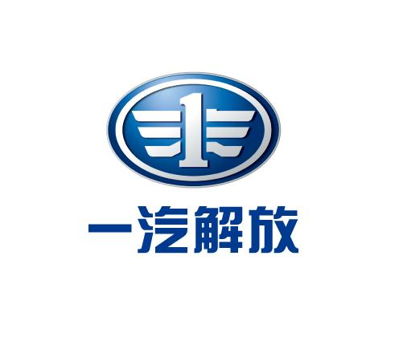



















GANT Software Solutions Customer Reference
State-Owned Brands
private enterprise Brands
New Brands

Slide 5
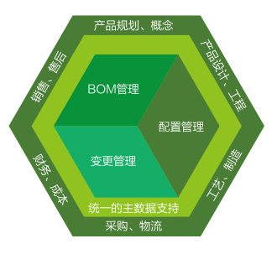
Combining Configuration / BOM / Change management into on platform
1
Integrated, loose-coupling business BOM
Full Lifecycle Configuration Management
Completed coverage from early planning phase to after-sales phase
3
Product Planning, Concept
Make sure configuration data synchronization cross value chain
Support free option model
Early BOM
EBOM
Sales, after-sales
BOM
Management
Product Design, engineering
Prototype BOM
MBOM
Change
Management
Configuration
Management
SBOM
Finance, Cost
Manufacturing Engineering
Single Mast Data Source
KD BOM
Enterprise level change management
Procurement, Logistic
2
Full value chain coverage
Change process drive BOM data status and effectivity change

Slide 6
1. Integrated, loose-coupling business BOM
R&D Area BOM (Early BOM → Engineering BOM)
Support multiple business areas involving vehicle development at early stage
Prototype vehicle definition
Prototype plan
Prototype part status and timing
Prototype part supplier selection
Prototype process planning
Prototype vehicle status
Subsidiary material
Plant level outsourcing parts and part supply information
Manufacturing Process Management
Color Parts Management
Breakpoint
After sales special part / Fit Package
Color Parts after sales strategy
After sales Substitution relationship
After sales breakpoint
Domestic MBOM
Overseas MBOM
KD BOM
Localization
KD special parts
KD Suppliers
KD Process Planning Information
Overseas Plant BOM
Joined Manufacturing
Prototype BOM
Multiple phases, multiple batches
MBOM
Multiple Plants
SBOM
Effectiveness management for full vehicle models
Powertrain Prototype
Chassis
Prototype
1st
Prototype
2nd
Prototype
Same model, different plants
Cross plants production
Developing
Models
On-Production Models
Models Sold
Domestic Mfg.
Overseas
Mfg.
KD
Shipment

Slide 7
1. Integrated, loose-coupling business BOM
Using MBOM as a sample to show how EBOM & MBOM are integrated tightly and data synchronized automatically.
Vehicle Management
EBOM
Engineering Change
Engineering Release
Platform
Model1
✓
1. Select model to build MBOM
2. Building MBOM based on plants
3. Change synchronization automatically
Plant-n
Plant……
Model2
Plant-1
MBOM Create
MBOM Maintain
Release & Change
Model3
✓
Standard Process Planning Lib.
Automatically Mapping
Raw materials
MCO
……
Routing Template Lib.
Solution 1
4. Built-in routing mapping functions
Phantom Items
TCO
Model-n
subsidiary material
✓
Part Routing Lib.
Solution 2
Breakpoint
Routing information
Color BOM Resolve
6. Manufacturing change management, integrated with engineering change process
Configurable BOP
Solution 3
5. MBOM re-structure

Slide 8
2. Enterprise level change management
R&D Area BOM (Early BOM → Engineering BOM)
与策划业务融合、面向同步工程、多领域协同参与产品研发（成本、重量、采购、售后等的早期介入）
Engineering Release & Change
Engineering Release & Change
Engineering Release & Change
Engineering Release & Change
Engineering Release & Change
Prototype vehicle definition
Prototype plan
Prototype part status and timing
Prototype part supplier selection
Prototype process planning
Prototype vehicle status
Subsidiary material
Plant level outsourcing parts and part supply information
Manufacturing Process Management
Color Parts Management
Breakpoint
After sales special part / Fit Package
Color Parts after sales strategy
After sales Substitution relationship
After sales breakpoint
Domestic MBOM
Overseas MBOM
KD BOM
Localization
KD special parts
KD Suppliers
KD Process Planning Information
Change
Planning
Change Execute
Prototype Change
Manufacturing Change
Temporary Change
AfterSalesChange
KD Change
Prototype BOM
Multiple phases, multiple batches
MBOM
Multiple Plants
SBOM
Effectiveness management for full vehicle models
Overseas Plant BOM
Joined Manufacturing
Effectivities Management
不同制造基地切换时间不同
基于生产切换时间设定售后切换时间
基于国内生产切换时间设定海外切换时间
Change Effected
Breakpoint Management

Slide 9
3. Full Lifecycle Configuration Management
Make sure configuration data synchronization cross value chain
Support free option model
Product Development Process
Order Delivering
Concept
Trail Production
SOP
Milestone
Sales Price
Feasibility/ cost analysis
Validation
Validation
Configuration Management
Free Option Based Vehicle Selection
Vehicle Model Planning
Model Specification
Engineering Configuration
Eng. Release
Synchronization
Order Configuration Create
Production Configuration
Sales Configuration
Order Create
Rule Apply
Rule Apply
Rule Apply
Order Planning
产品配置
约束规则
Order Configuration Check
Passed
Order Delivering

Slide 10
System Integration Framework
Enterprise BOM Platform will integrate closely with business applications.
Enterprise BOM Platform
1
2
3
4
5
6
7
8
9
10
11
Vehicle / Model Master data
Part Master Data
Change Order
Design change status
Part Status
3D/2D Master Data
Procurement BOM
Part Sourcing Status
APQP Status
EBOM
ECO
Routing Information
Part Master Data
MBOM/KD BOM
Vehicle Model Master Data
Feature list
Change Information
Break Point
Vehicle Model Master Data
SBOM
Change information
Sales Configuration
Project Part List
PDM/PLM
Procurement System
Process Planning System
ERP
EPC
MES
DMS
Project Management System (Parts Based)
R&D
Procurement
Process Planning
Production
Sales / Aftersales
* Note: only key integration information described in above interface

Slide 11
谢谢！
2021年9月17日 Friday

